Slide 1

Introduction
Microsoft's Venture into Movie Production: Key Insights for Success

Slide 2
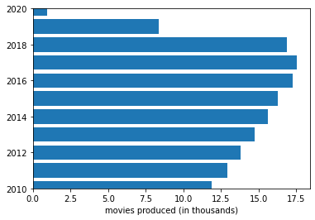
Movie Production Trends
Understanding the Dynamic Landscape: Value Counts of Movies Over the Years
Temporal Trends, Genre Shifts, and Cultural Influences
Rise, Peak, and Decline: Insights from the Horizontal Bar Graph

Slide 3
Movie Production Trends (Cont.)
Factors Contributing to the Decline: External Events and Industry Adaptability
Lessons for Filmmakers: Navigating Challenges and Seizing Opportunities

Slide 4
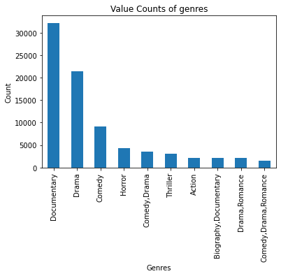
Genre Popularity
Crucial Role of Genre Value Counts in Industry Navigation
Shaping Content Strategy, Targeting Audiences, and Allocating Resources
Insights from Top Ten Produced Genres: Dominance of Documentaries, Drama, and Comedy
Balancing Popular Genres with Niche Offerings for Audience Engagement

Slide 5
Grouping Studios and Income
Strategic Approach: Grouping Studios by Annual Income
Assessing Market Share, Financial Health, and Strategic Decision-Making

Slide 6
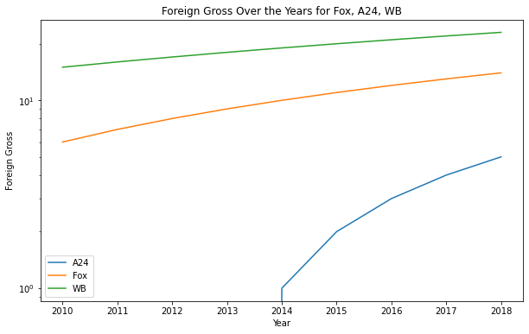
Continuous Increase in Foreign Gross
Positive Trend: Movies' Global Success Reflected in Increasing Foreign Gross
Factors Contributing to Success: Globalization, Expanded Distribution, and Marketing Strategies

Slide 7
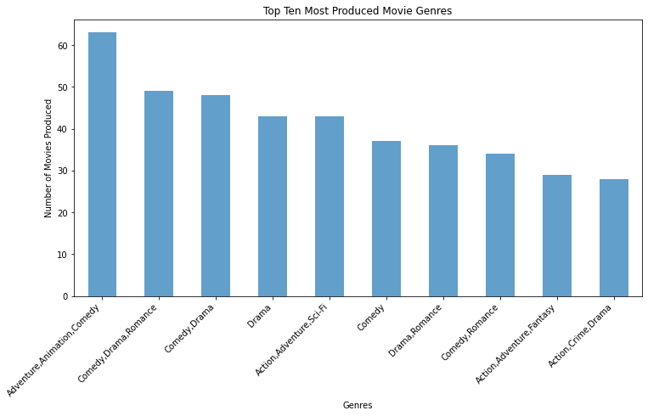
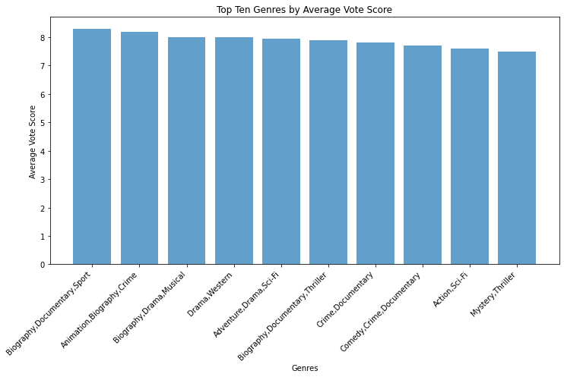
Popular Genres vs. Comedy Productions
This graph displays the prevalent repetitive production of comedy related movies.
Even though comedy productions were more, the more popular genres were documentary related movies.

Slide 8
Conclusion
Comprehensive Insights for Strategic Decision-Making in the Film Industry
Primary Recommendation: Documentary Production for Stability and High Returns
Additional Recommendations
Explore Niche Genres for Innovation and Engagement
Form Strategic Partnerships for Enhanced Reach and Impact
Align with Social Trends: Make Films Reflecting Current Topics

Slide 9
Summary
Global Market Adaptability
Proven Success: Studios Adapting to Global Markets and Cultural Diversity
Amplifying Success through International Audience Understanding
Diversified Investment Strategy: Stability, Innovation, and Global Adaptability
Positioning Investors for Success in the Dynamic Film Industry

Slide 10
Thank You!
Compiled and presented by Shuru Ebale
Email: shuruxebale@gmail.com

